Slide 1


Data Science Capstone Project
Final Peer- Review Assignment
Samuel Atuahene
March 10th, 2022

Slide 2

Outline
Executive Summary
Introduction
Methodology
Results
Conclusion
Appendix

Slide 3
Executive Summary
Summary of methodologies
Data collection
Data wrangling
EDA with data visualization
EDA with SQL
Building an interactive map with Folium
Building a Dashboard with Plotly Dash
Predictive analysis (Classification)
Summary of all results
Exploratory data analysis results
Interactive analytics demo in screenshots
Predictive analysis results

Slide 4
Introduction
Project background and context
The commercial space era is come, and various businesses are making space travel accessible to the general public. SpaceX is perhaps the most successful of them all, and one of the reasons for this is the low cost of their rocket launches.
On its website, SpaceX advertises Falcon 9 rocket flights for 62 million dollars; other suppliers charge upwards of 165 million dollars per launch; much of the savings comes from the fact that SpaceX can reuse the first stage.
As a result, we'll forecast whether the Falcon 9's first stage will successfully land. If we can figure out if the first stage will land, we can figure out how much a launch will cost. If another firm wishes to compete with SpaceX for a rocket launch, this information can be used.
Problems you want to find answers
- Correlations between each rocket variables and successful landing rate
- Conditions to get the best results and ensure the best successful landing rate

Slide 5

Section 1

Slide 6
Methodology
Executive Summary
Data collection methodology:
SpaceX API & Web Scraping Falcon 9 and Falcon Heavy Launches Records from Wikipedia
Perform data wrangling
Convert outcomes into Training Labels with the booster successfully/unsuccessful landed
Perform exploratory data analysis (EDA) using visualization and SQL
Perform interactive visual analytics using Folium and Plotly Dash
Perform predictive analysis using classification models
Find best Hyperparameter for SVM, Classification Trees and Logistic Regression

Slide 7
Data Collection
The data collection process includes a combination of API requests from the SpaceX API and web scraping data from a table in the Wikipedia page of SpaceX, Falcon 9 and Falcon Heavy Launches Records.
SpaceX API Data Columns: FlightNumber, Date, BoosterVersion, PayloadMass, Orbit, LaunchSite, Outcome, Flights, GridFins, Reused, Legs, LandingPad, Block, ReusedCount, Serial, Longitude, Latitude
Wikipedia Web Scrape Data Columns: Flight No., Launch site, Payload, PayloadMass, Orbit, Customer, Launch outcome, Version Booster, Booster landing, Date, Time
SpaceX API
Web Scraping
Request
data
from
SpaceX
API
API
returns
SpaceX
Data in
.JSON file
Normalize
data
into
CSV file
Get HTML
Response
from
Wikipedia
page
Extract
data
using
beautiful
soup
Normalize
data
into
CSV file

Slide 8
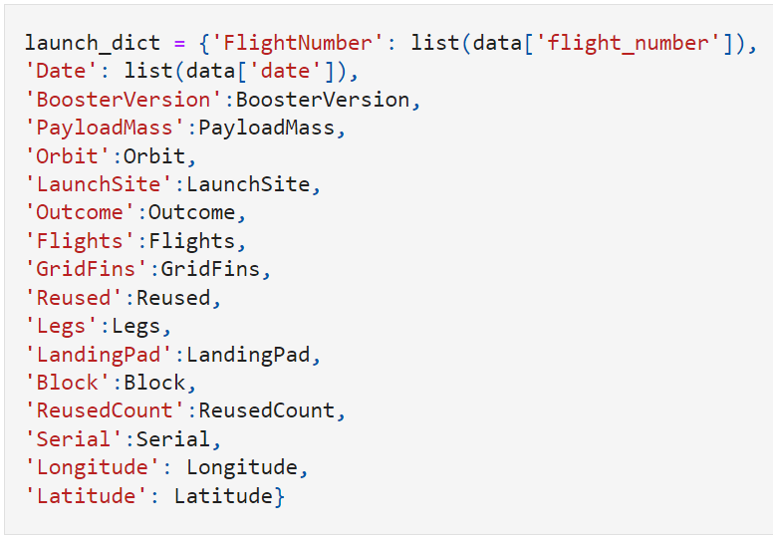
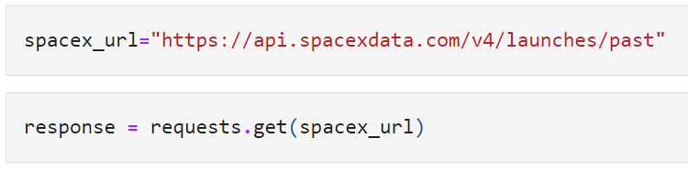
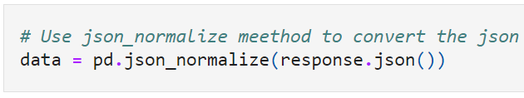
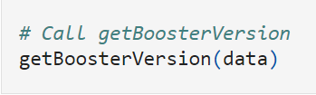
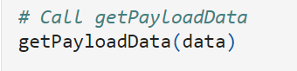
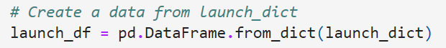
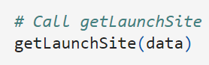
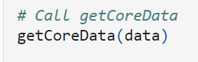
Data Collection – SpaceX API
4. Combining the columns into a dictionary to create data frame
1. Requesting rocket launch data from SpaceX API
2. Converting Response to a JSON file
3. Using custom functions to clean data
5. Filtering dataframe and exporting to a CSV

Slide 9
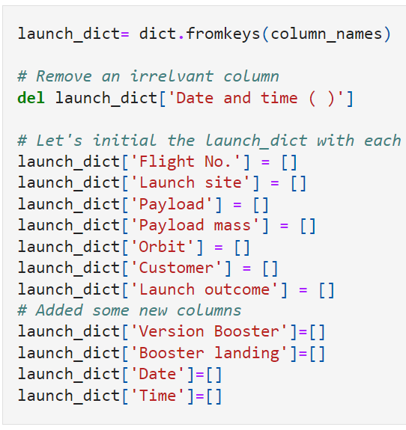
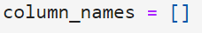
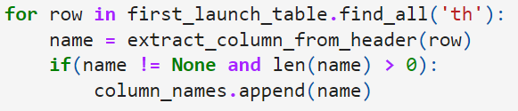
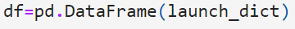
Data Collection - Scraping
1.Getting response from HTML
5.Creating an empty dictionary with keys
2.Creating a BeautifulSoup object
3.Finding all tables and assigning the result to a list
4.Extracting column name one by one
6.Filling up the launch_dict with launch records
(Too long to put in here, so please refer to the notebook)
7.Creating a Dataframe and exporting it to a CSV

Slide 10
Data Wrangling
There are several cases in which the booster failed to successfully land on the dataset, and sometimes it attempted to land but failed because of accident.
• Converting these results into training labels:
1 = successful / 0 = failure
True Ocean: the mission result has successfully landed in a specific area of the ocean
False Ocean: the mission result has not successfully landed in a specific area of the ocean
True RTLS: the mission result successfully landed on the ground pad
False RTLS: the mission result has not successfully landed on the ground pad
True ASDS: the mission result has successfully landed on the drone ship
False ASDS: the mission result has not landed on the drone ship

Slide 11
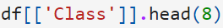
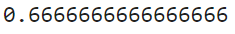
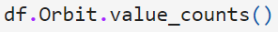
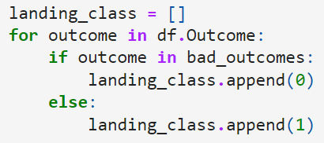
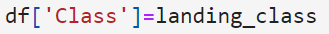
Data Wrangling
1.Calculating the number of launches at each site
5.Calculating the success rate for every landing in
dataset
2.Calculating the number and occurrence of each orbit
6.Exporting dataset to a CSV
3.Calculating the number and occurrence of mission
outcome per orbit type
4.Creating a landing outcome label from Outcome column

Slide 12
EDA with Data Visualization
Scatter chart:
Flight Number vs. Launch Site
Payload vs. Launch Site
Flight Number vs. Orbit Type
Payload vs. Orbit Type
A scatter plot shows how much one variable is affected by another. The relationship between two variables is called a correlation. This plot is generally composed of large data bodies.
• Bar chart:
Orbit Type vs. Success Rate
A Bar chart makes it easy to compare datasets between multiple groups at a glance. One axis represents a category and the other axis represents a discrete value. The purpose of this chart is to indicate the relationship between the two axes.
• Line chart:
Year vs. Success Rate
A Line chart shows data variables and trends very clearly and helps predict the results of data that has not yet been recorded.

Slide 13
EDA with SQL
Loading the dataset into the corresponding table in a Db2 database, and executing SQL queries to answer following questions:
Displaying the names of the unique launch sites in the space mission
Displaying 5 records where launch sites begin with the string 'CCA'
Displaying the total payload mass carried by boosters launched by NASA (CRS)
Displaying average payload mass carried by booster version F9 v1.1
Listing the date when the first successful landing outcome in ground pad was achieved
Listing the names of the boosters which have success in drone ship and have payload mass greater than 4000 but less than 6000
Listing the total number of successful and failure mission outcomes
Listing the names of the booster_versions which have carried the maximum payload mass
Listing the failed landing_outcomes in drone ship, their booster versions, and launch site names for in year 2015
Ranking the count of landing outcomes (such as Failure (drone ship) or Success (ground pad)) between the date 2010-06-04 and 2017-03-20, in descending order

Slide 14
Build an Interactive Map with Folium
• Objects created and added to a folium map:
Markers that show all launch sites on a map
Markers that show the success/failed launches for each site on the map
Lines that show the distances between a launch site to its proximities
• By adding these objects, following geographical patterns about launch sites are found:
Are launch sites in close proximity to railways? Yes
Are launch sites in close proximity to highways? Yes
Are launch sites in close proximity to coastline? Yes
Do launch sites keep certain distance away from cities? Yes

Slide 15
Build a Dashboard with Plotly Dash
The dashboard application contains a pie chart and a scatter point chart.
○ Pie chart
■ For showing total success launches by sites
■ This chart can be selected to indicate a successful landing distribution across all launch sites or to indicate the success rate of individual launch sites.
○ Scatter chart
■ For showing the relationship between Outcomes and Payload mass (Kg) by different
boosters
■ Has 2 inputs: All sites/individual site & Payload mass on a slider between 0 and 10000 kg
■ This chart helps determine how success depends on the launch point, payload mass,
and booster version categories.

Slide 16
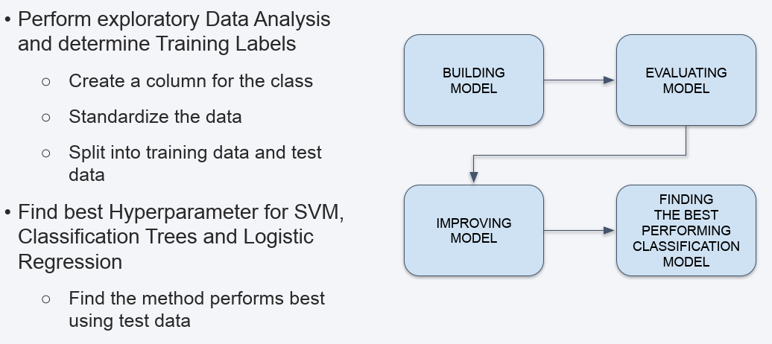
Predictive Analysis (Classification)

Slide 17
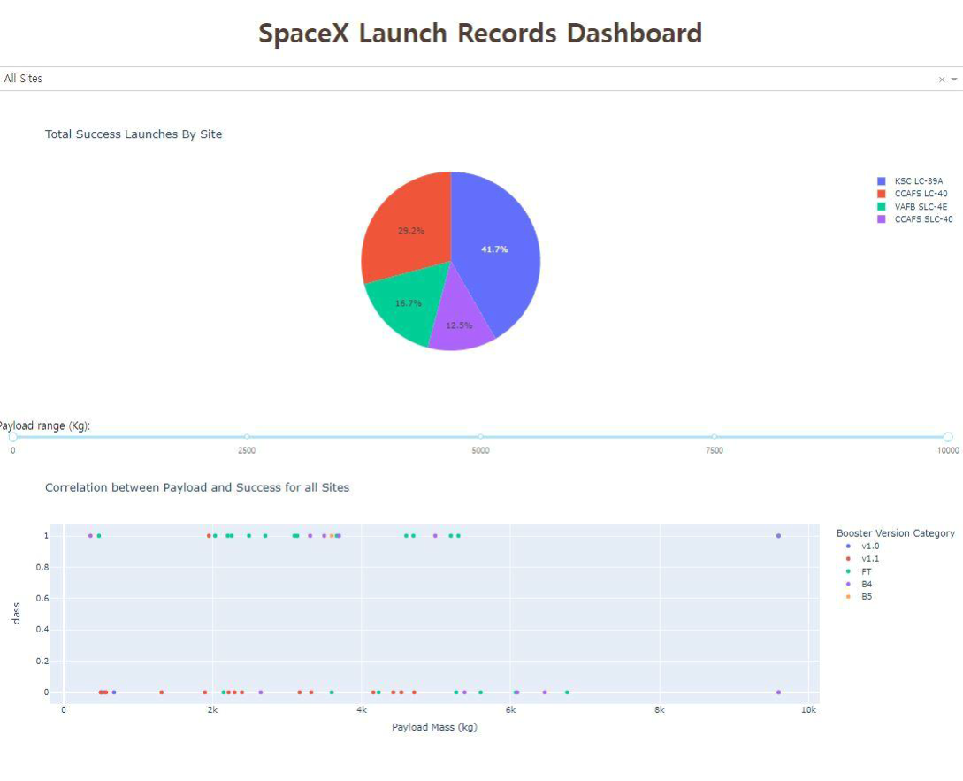
Results
The left screenshot is a preview of the Dashboard with Plotly Dash.
The results of EDA with visualization, EDA with SQL, Interactive Map with Folium, and Interactive Dashboard will be shown in the next slides.
Comparing the accuracy of the four methods, all return the same accuracy of about 83% for test data.

Slide 18

Section 2

Slide 19
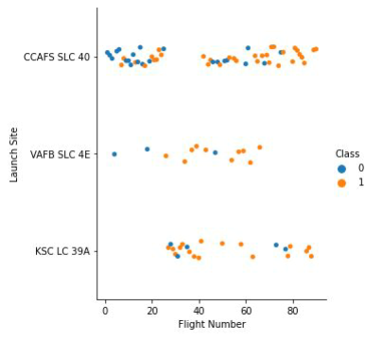
Flight Number vs. Launch Site
• Class 0 (blue) represents
unsuccessful launch, and Class 1
(orange) represents successful launch.
This figure shows that the success rate increased as the number of flights increased.
• As the success rate has increased considerably since the 20th flight, this point seems to be a big breakthrough.

Slide 20
Payload vs. Launch Site
• Class 0 (blue) represents
unsuccessful launch, and Class 1
(orange) represents successful launch.
At first glance, the larger pay load mass, the higher the rocket's success rate, but it seems difficult to make decisions based on this figure because no clear pattern can be found between successful launch and Pay Load Mass.

Slide 21
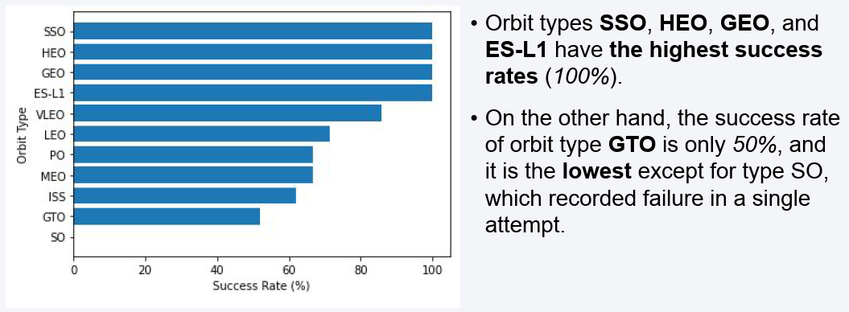
Success Rate vs. Orbit Type

Slide 22
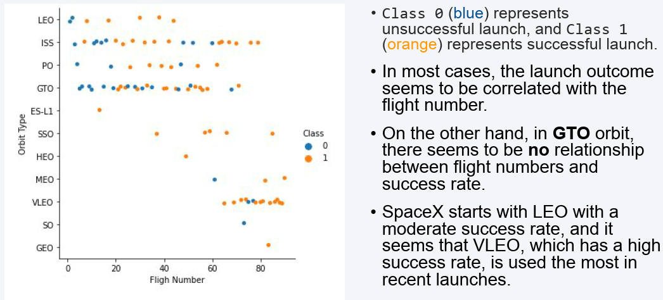
Flight Number vs. Orbit Type

Slide 23
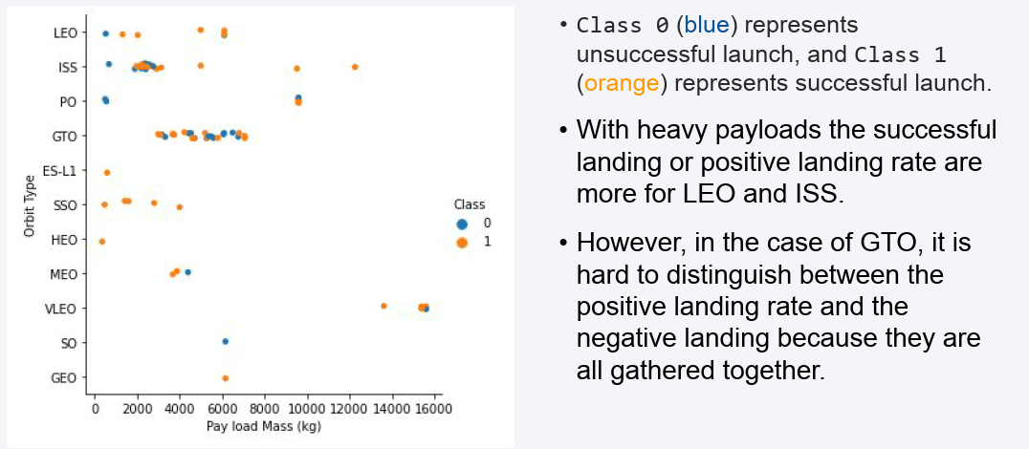
Payload vs. Orbit Type

Slide 24
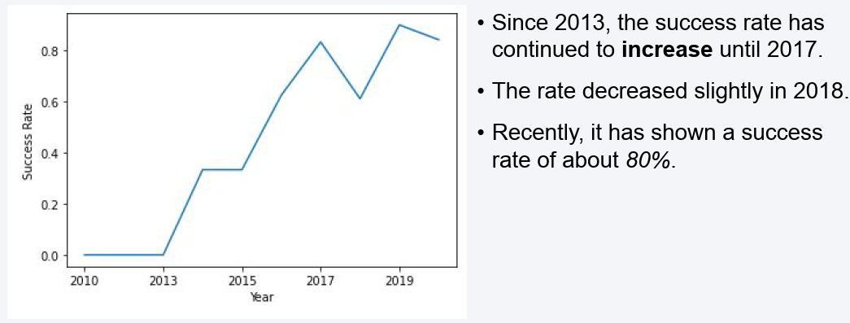
Launch Success Yearly Trend

Slide 25
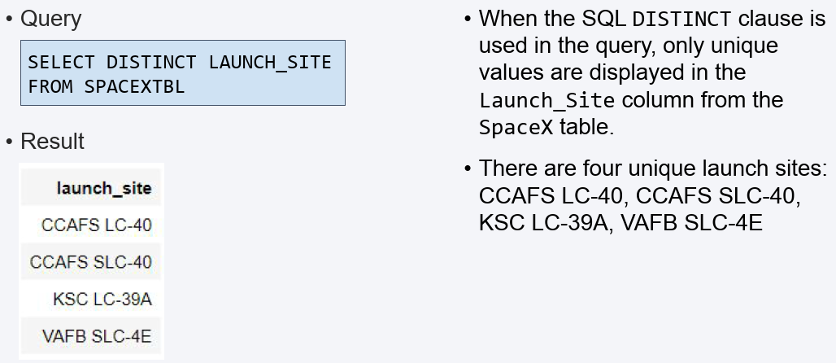
All Launch Site Names

Slide 26
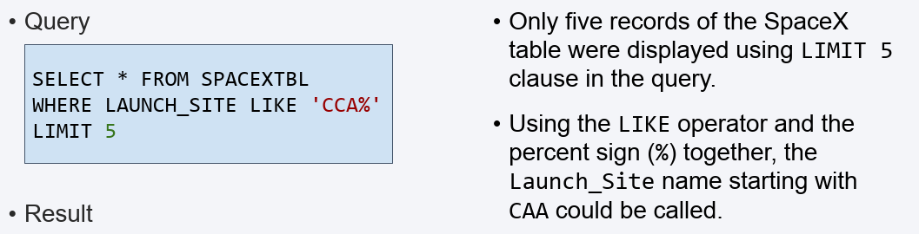
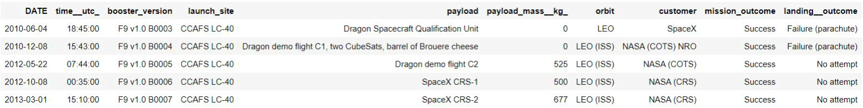
Launch Site Names Begin with 'CCA'

Slide 27
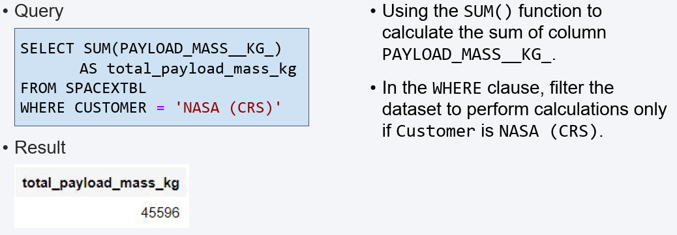
Total Payload Mass

Slide 28
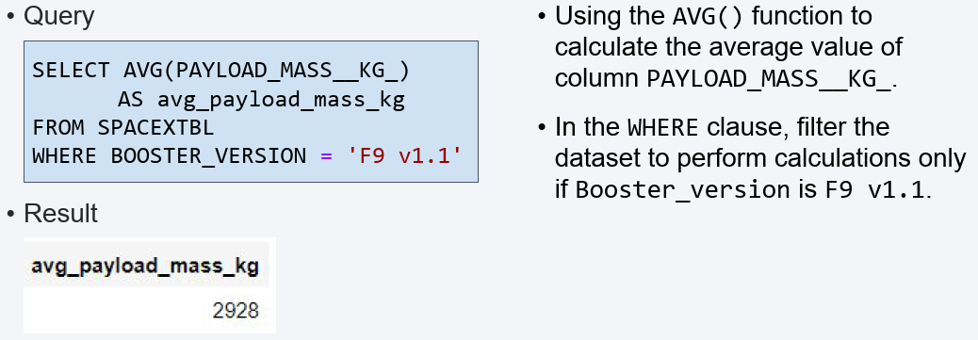
Average Payload Mass by F9 v1.1

Slide 29
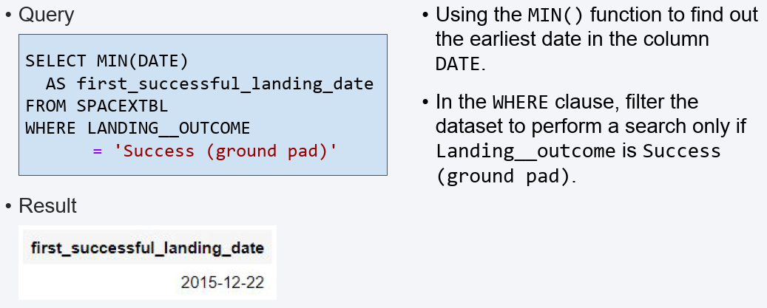
First Successful Ground Landing Date

Slide 30
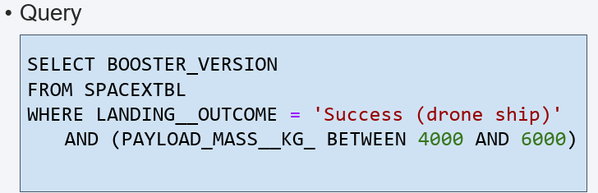
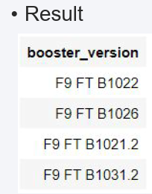
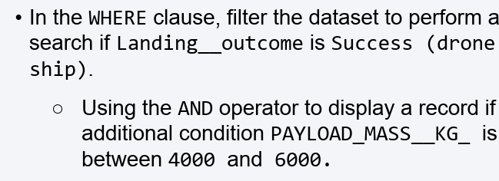
Successful Drone Ship Landing with Payload between 4000 and 6000

Slide 31
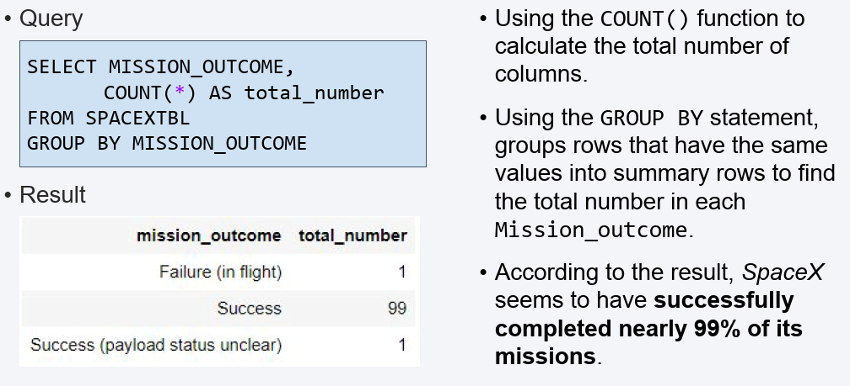
Total Number of Successful and Failure Mission Outcomes

Slide 32
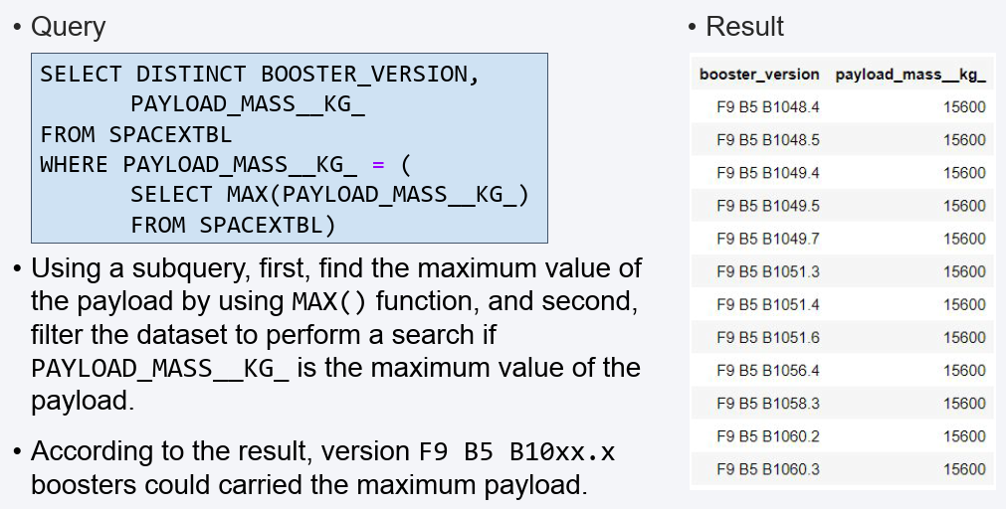
Boosters Carried Maximum Payload

Slide 33
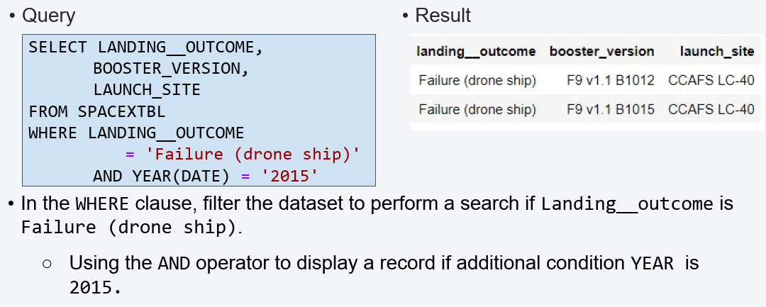
2015 Launch Records

Slide 34
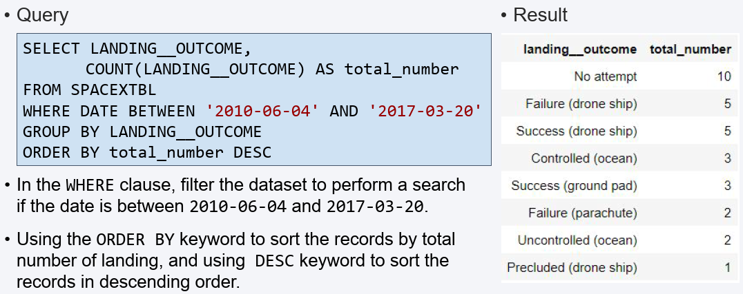
Rank Landing Outcomes Between 2010-06-04 and 2017-03-20

Slide 35

Section 3

Slide 36
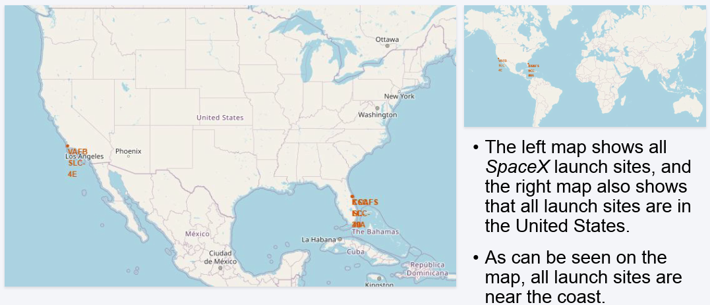
All Launch Sites’ Locations

Slide 37
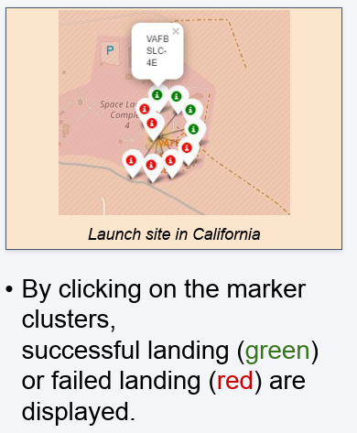
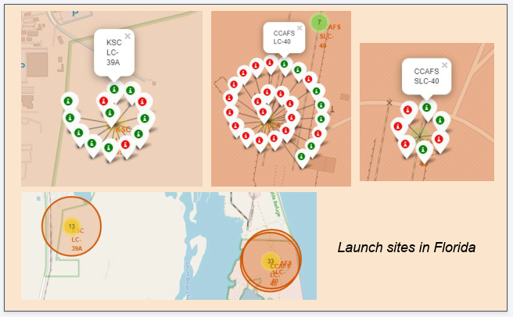
Color-labeled Launch Outcomes

Slide 38
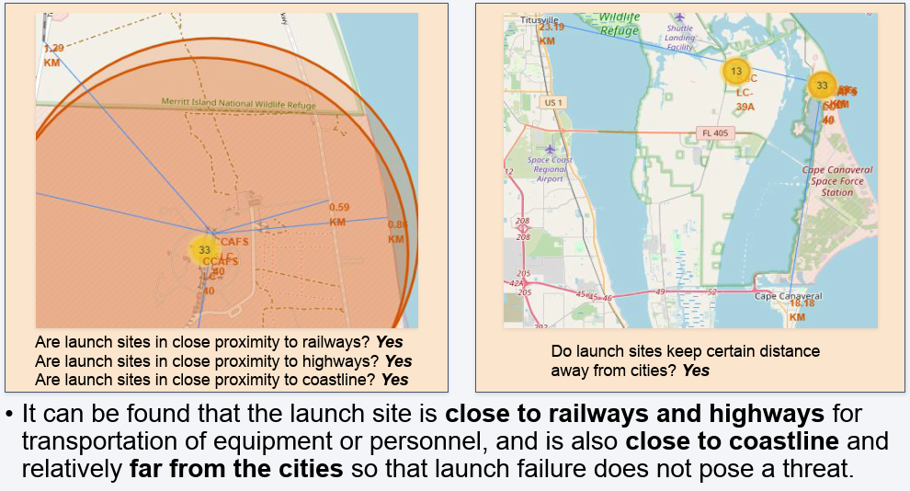
Proximities of Launch Sites

Slide 39

Section 4

Slide 40
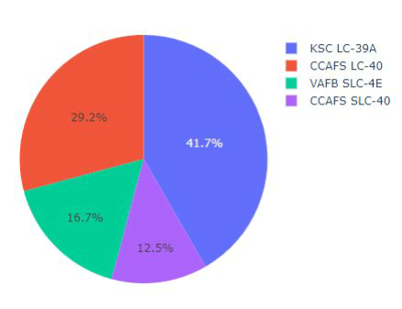
Total Success Launches By all sites
KSLC-39A records the most launch
success among all sites.
The VAFB SLC-4E has the fewest launch
success, possibly because
the data sample is small, or
because it is the only site located in California, so the launch difficulty on the west coast may be higher than on the east coast.

Slide 41
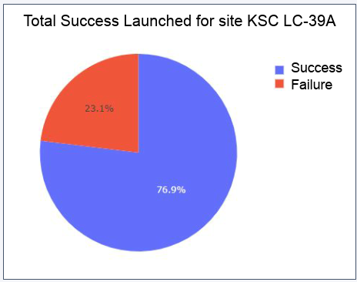
Launch Site with Highest Launch Success Ratio
KSLC-39A has the highest success rate with 10 landing successes (76.9%) and 3 landing failures (23.1%).

Slide 42
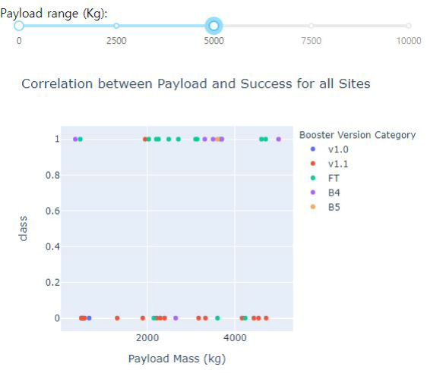
Payload vs. Launch Outcome Scatter Plot for all sites
These figures show that the launch success rate (class 1) for low weighted payloads(0-5000 kg) is higher than that of heavy weighted payloads(5000-10000 kg).

Slide 43

Section 5

Slide 44
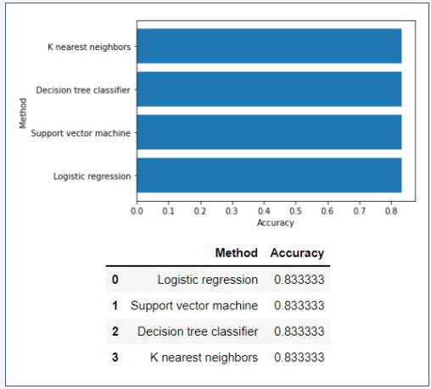
Classification Accuracy
In the test set, the accuracy of all models was virtually the same at 83.33%.
It should be noted that the test size was small at 18.
Therefore, more data is needed to determine the optimal model.

Slide 45
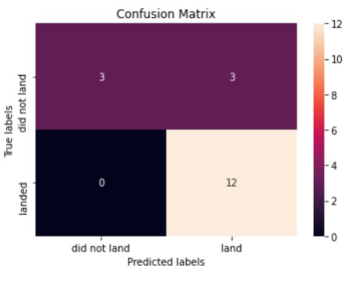
Confusion Matrix
The confusion matrix is the same for all models because all models performed the same for the test set.
The models predicted 12 successful landings when the true label was successful and 3 failed landings when the true label was failure. But there were also 3 predictions that said successful landings when the true label was failure (false positive).
Overall, these models predict successful landings.

Slide 46
Conclusions
As the number of flights increased, the success rate increased, and recently it has exceeded 80%.
Orbital types SSO, HEO, GEO, and ES-L1 have the highest success rate (100%).
The launch site is close to railways, highways, and coastline, but far from cities.
KSLC-39A has the highest number of launch successes and the highest success rate among all sites.
The launch success rate of low weighted payloads is higher than that of heavy weighted payloads.
In this dataset, all models have the same accuracy (83.33%), but it seems that more data is needed to determine the optimal model due to the small data size.

Slide 47
Appendix

Slide 48


